Slide 1
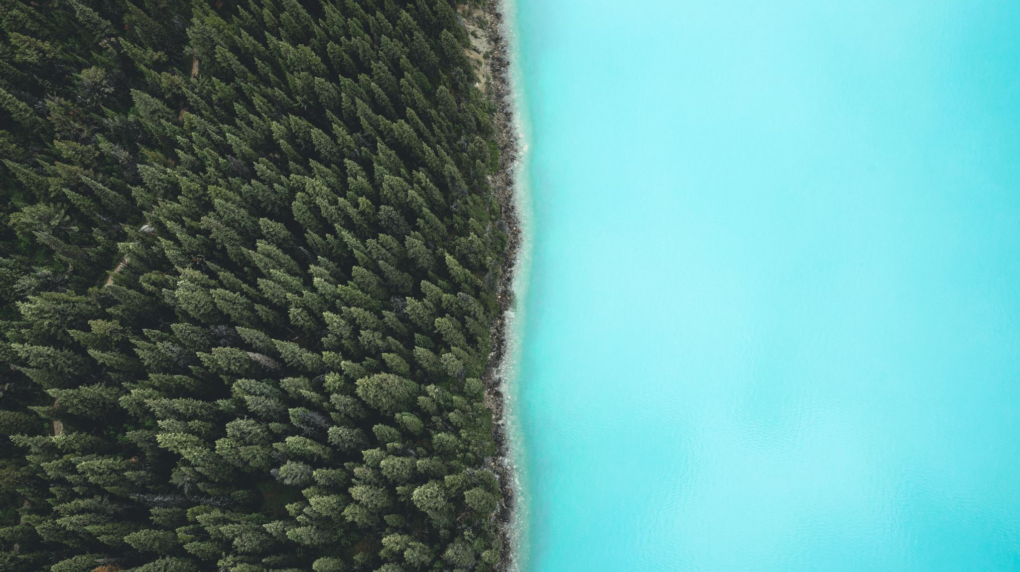
Mini Project
Invisible Cloak Make Visible Thing Invisible
Ayush Kushwaha
1901640100089

Slide 2
Introduction
This project is actually inspire from the cloak which is used in Harry Potter Movie. As in movie when harry put this cloak on itself it become invisible same as it in this program when a person put the cloak he/she will become invisible.

Slide 3

Programing Language Used
I am going to use python to develop this program We can also do this using C++ but it will become more complicate and it is very simple in python as compare to C++

Slide 4


Libraries Used In Python
OpenCV
NumPy
To Capture Video, Processing The Video, Creating The Output, Masking etc
To Storing The HSV Values And For Computing Them

Slide 5
How It Works
Capture And Store The Background
Set The HSV Values
Detecting The Cloak By Its Colour(Using The HSV Values)
Cutting that part by generating a mask
Final Output Will By Background + Mask

Slide 6
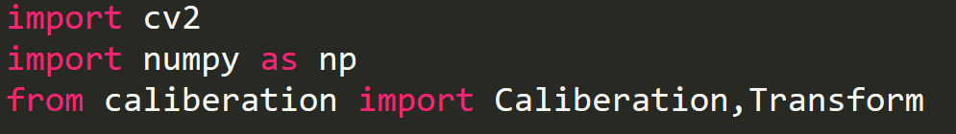

Code Snippets
Importing The Libraries
Set vc to access the WebCam

Slide 7
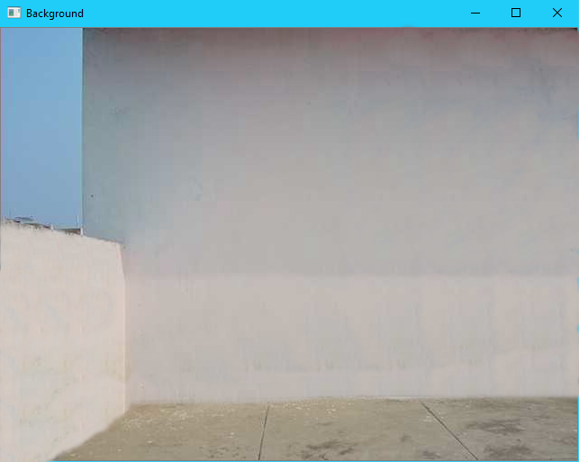
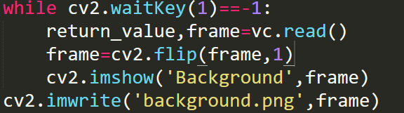
Capturing And Storing The Background

Slide 8
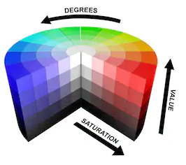
What Are HSV?
The HSV (which stands for Hue Saturation Value) scale provides a numerical readout of your image that corresponds to the color names contained therein. Hue is measured in degrees from 0 to 360
HUE
Hue is the color portion of the model, expressed as a number from 0 to 360 degrees:
Red falls between 0 and 60 degrees.
Yellow falls between 61 and 120 degrees.
Green falls between 121 and 180 degrees.
Blue falls between 241 and 300 degrees.
Magenta falls between 301 and 360 degrees.

Slide 9
SATURATION
Saturation describes the amount of gray in a particular color, from 0 to 255. Reducing this component toward zero introduces more gray and produces a faded effect. Sometimes, saturation appears as a range from 0 to 255, where 0 is gray, and 255 is a primary color.
VALUE (OR BRIGHTNESS)
Value works in conjunction with saturation and describes the brightness or intensity of the color, from 0 to 255 , where 0 is completely black, and 255 is the brightest and reveals the most color.

Slide 10
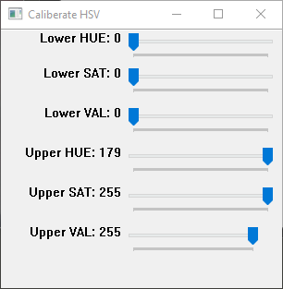
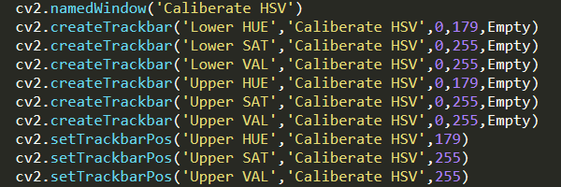
Seting The HSV Values

Slide 11
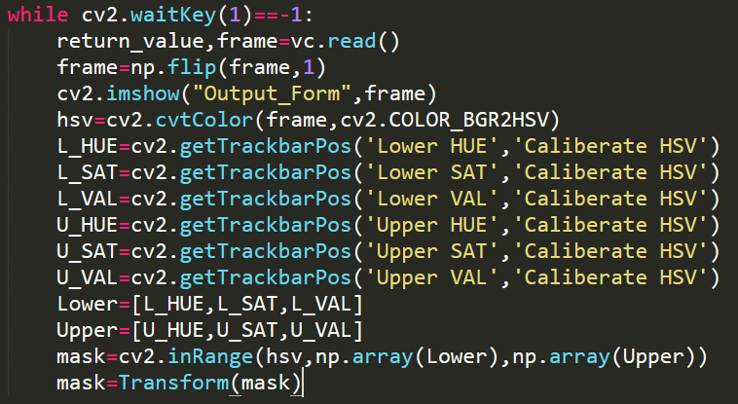

Slide 12
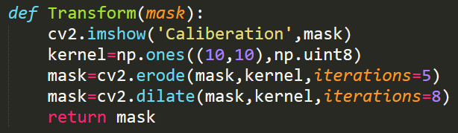
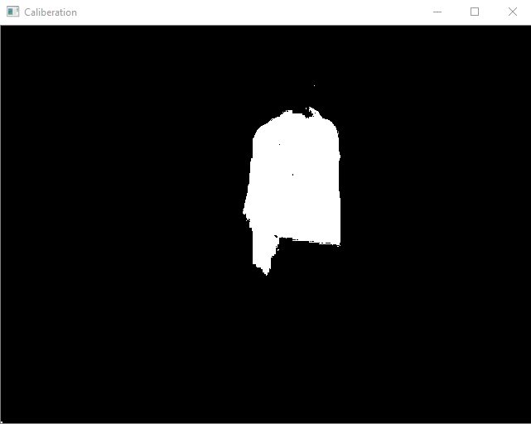
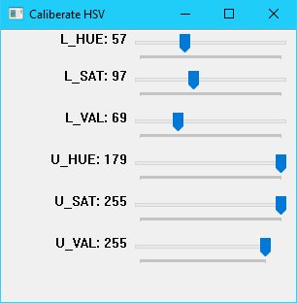

Slide 13
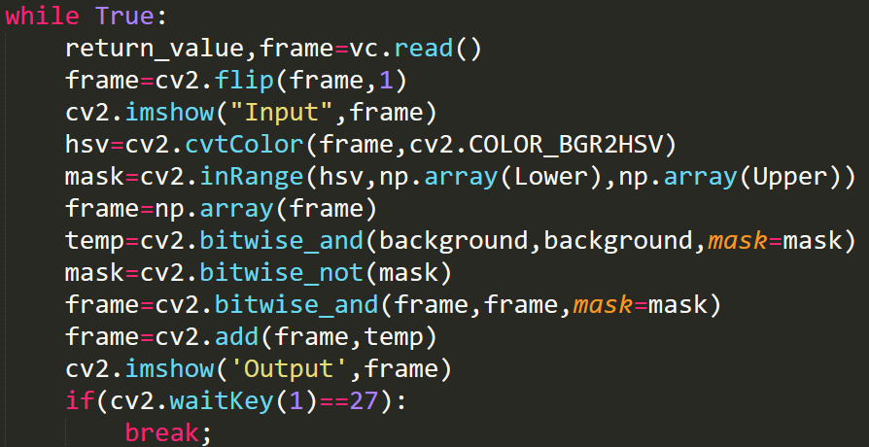
Masking And Output

Slide 14
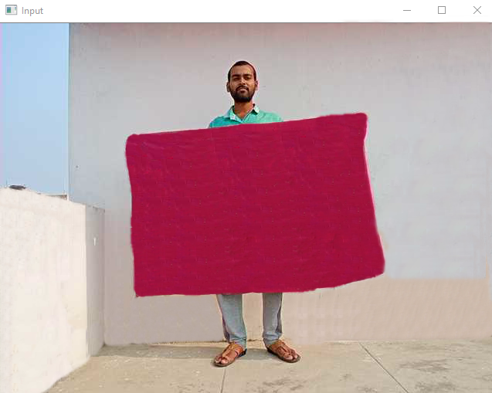
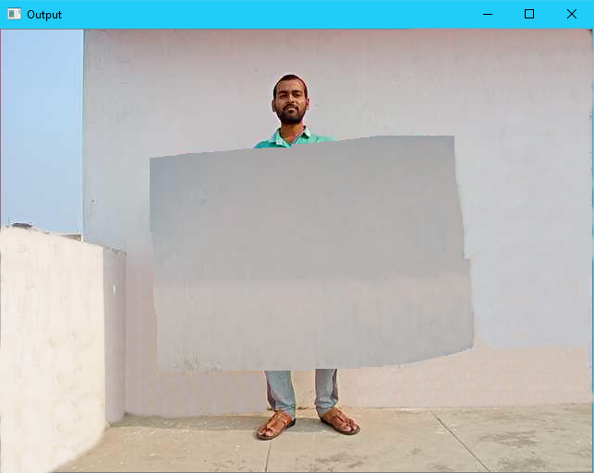
Original Video
Output Video

Slide 15
Thank You

